Slide 1

Society for Computer Technology and Research’s
Pune Institute of Computer Technology, Pune 43
“Design, Simulation & Fabrication of Antenna for MBAN Application”
Team members:
Prathmesh Ramesh Khose – T190053138
Om Shinde – T190053263
Prathmesh Prakash Kalamkar – T190053227
Guide Name:
Ms. Pratibha Tathe
Department of Electronics and Telecommunication Engineering,
P.I.C.T., Pune-43
Notes:
Department of Electronics and Telecommunication Engineering

Slide 2
Contents
Introduction
Microstrip antenna
Antenna designing specifications
Microstrip antenna calculations
Analysis of linear polarized microstrip patch antenna
Result
References

Slide 3
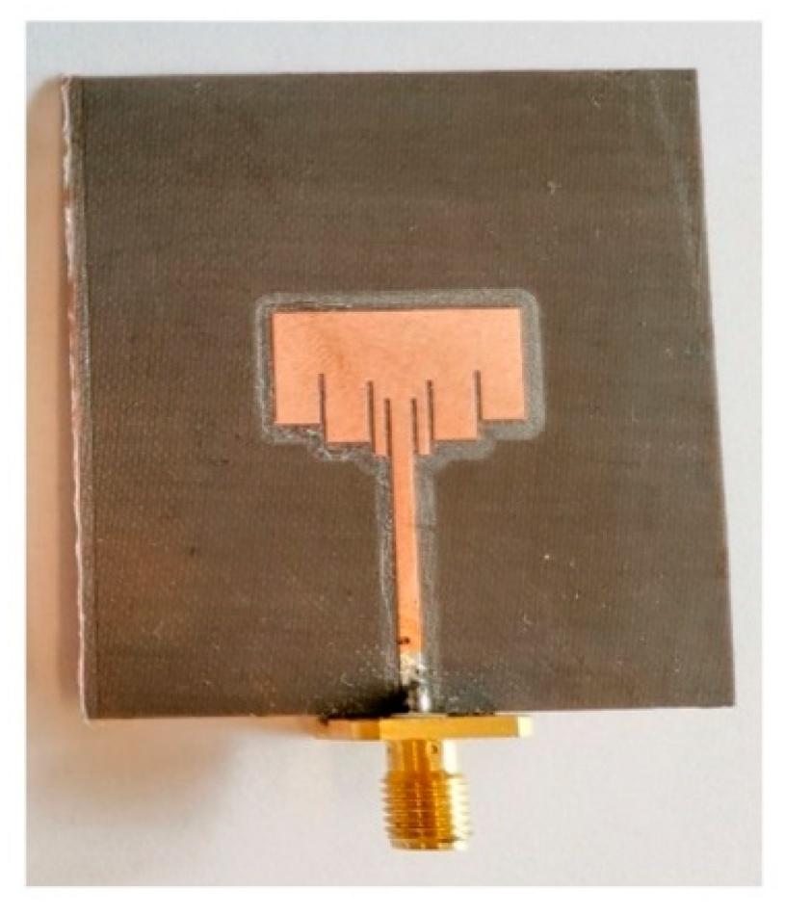
Introduction
What is an antenna?
An antenna is a device designed to transmit or receive electromagnetic waves. It is typically used in communication systems to facilitate the transmission and reception of radio frequency (RF) signals.
What is a microstrip antenna?
A microstrip patch antenna is a type of antenna that operates in the microwave frequency range. It is widely used in wireless communication systems, satellite communication, radar systems, and other applications where a compact and lightweight antenna is required.
What is MBAN?
MBAN stands for Medical Body Area Network. It is a wireless communication technology specifically designed for monitoring and collecting medical data from individuals within a short range, typically within a hospital or healthcare facility.
MBANs typically operate in the frequency band around 2360-2400 MHz, which has been allocated specifically for medical devices by regulatory bodies such as the Federal Communications Commission (FCC) in the United States.

Slide 4
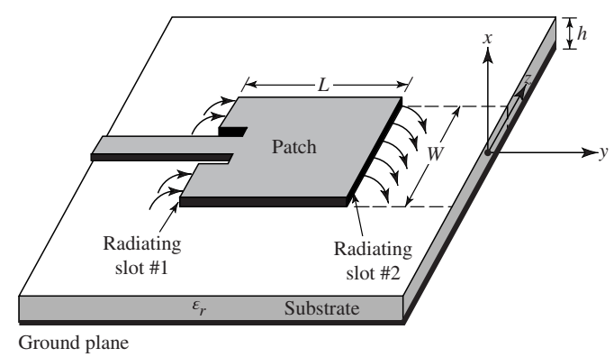
Microstrip antenna
The microstrip patch antenna consists of a flat metallic patch printed on one side of a dielectric substrate, with a ground plane on the opposite side. The patch and ground plane are typically separated by a thin layer of dielectric material. The patch is usually square, rectangular, circular, or some other specific shape, depending on the desired radiation pattern and characteristics.
Figure: Microstrip antenna

Slide 5
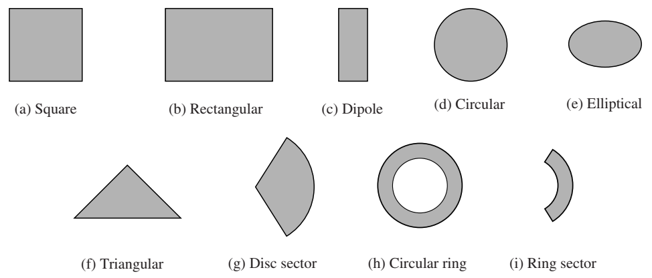
Shapes of microstrip patch elements
Figure: Shapes of microstrip patch elements.

Slide 6
Antenna Design specifications
Resonating frequency = 2.38 GHz
Substrate material= FR4
Substrate thickness = 1.6mm
Relative permittivity(ε_{r} ) = 4.4

Slide 7
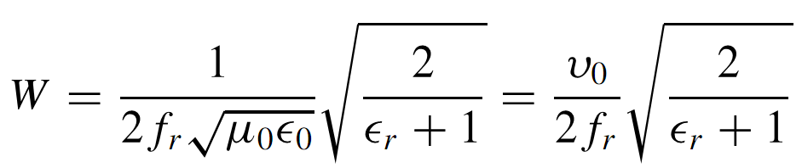
Microstrip Patch Antenna Calculation
Calculation of the Width (W)
W= 38.355921mm = 38.36mm
Where,
f_{r}=Resonant frequency of the Microstrip antenna
v₀ = is the speed of light in free space
ε_{o}= Permittivity of free space
µ₀= Permeability of free space

Slide 8
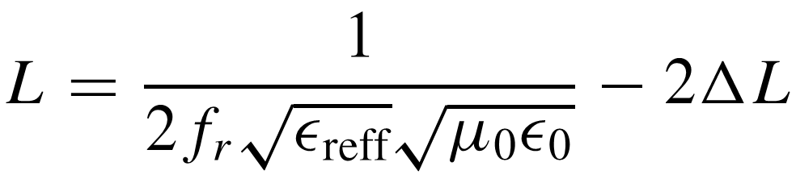
Microstrip Patch Antenna Calculation
The actual length of the patch can now be determined by solving for L.
L = 29.695394mm = 29.70mm

Slide 9
Finalization Microstrip Patch Antenna Width and Length
Square patch antenna area(A)= W X L
A = 29.70 * 38.36
A = 1139.292 mm^2
Side Length (x) = Square root (A) = (1139.292)^(1/2) = 33.76mm
Patch Length (Lp) = Patch width (Wp) = 29.16mm
Substrate Length (Ls) = substrate width (Ws) = 63.76mm

Slide 10
Analysis of Linear Polarized Microstrip Patch Antenna

Slide 11
Fundamental Parameters of Antenna
Return loss
VSWR
Radiation pattern
Directivity
Gain
Antenna efficiency
Half power beam width
Bandwidth
Polarization

Slide 12
Return Loss
0 < Γ < 1
When, Γ= 0
RL= Infinity
When, Γ=1
RL= 0dB
When, RL= -10(dB)
Hence Γ ≈ 0.3162
Reflected Power((P_{r}) = 31.62% of Incident Power((P_{i})

Slide 13
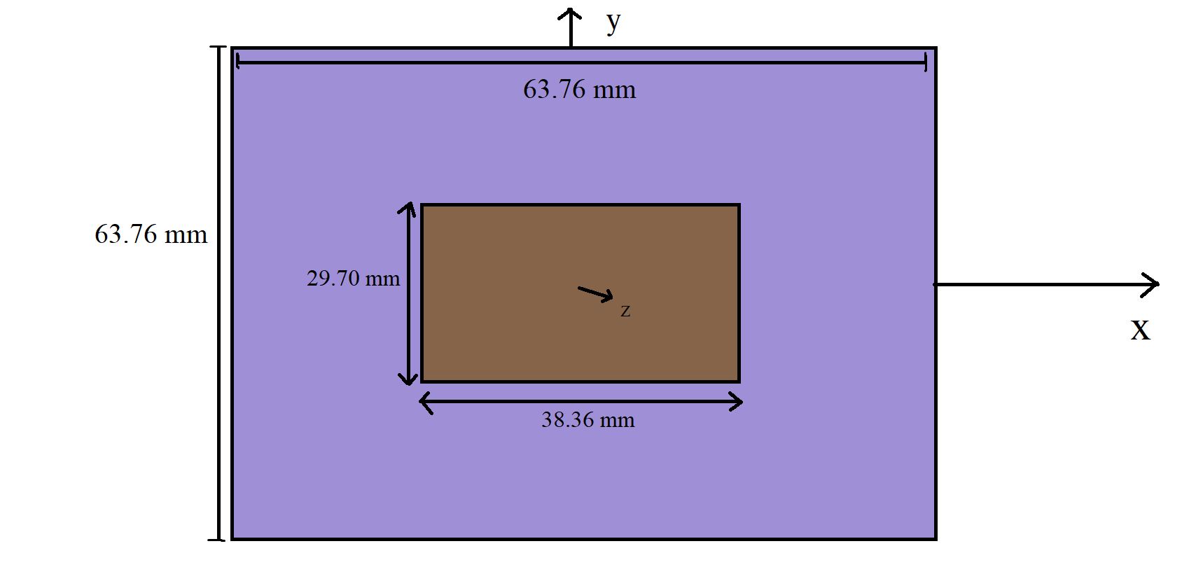
Structure of Microstrip Patch Antenna

Slide 14
Results Discussion
Return loss

Slide 15
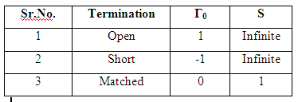
Reflection Coefficient
Reflected Power((P_{r}) = Γ * Incident Power((P_{i})
Transmitted Power((P_{t}) = τ * Incident Power((P_{i})

Slide 16
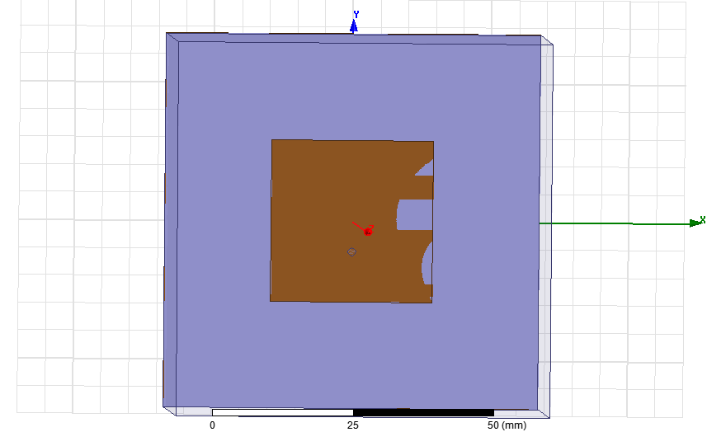
Structure of Microstrip Patch Antenna

Slide 17
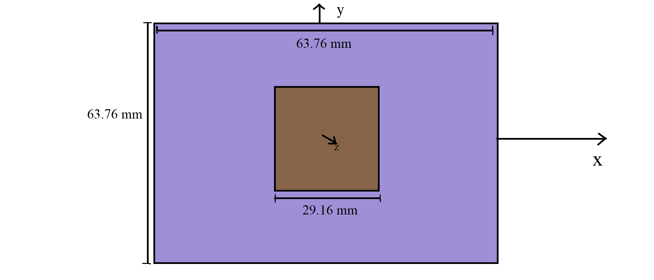
Structure of Microstrip Patch Antenna

Slide 18
Results Discussion
Return loss

Slide 19
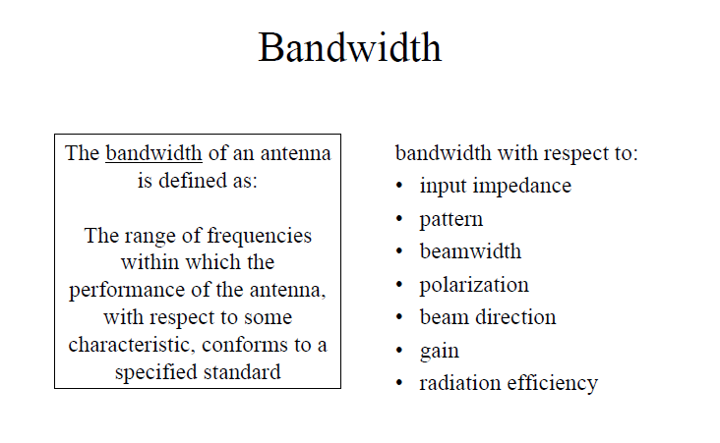
Results Discussion

Slide 20
Results Discussion
Bandwidth

Slide 21
VSWR Voltage Standing Wave Ratio
When Γ= 0; VSWR = 1
When Γ= 1; VSWR = ∞
1 < VSWR < ∞

Slide 22
Results Discussion
VSWR

Slide 23
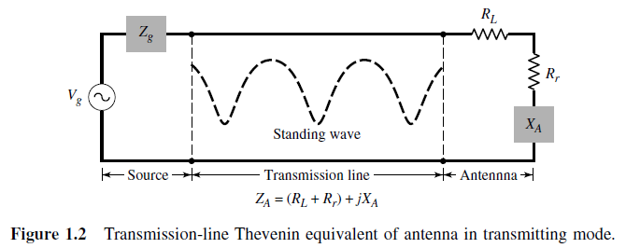
Input Impedance
The antenna impedance is represented by
Z_{A} = (R_{L} + R_{r} ) + j X_{A} R_{A} = ( R_{L} + R_{r} )
R_{L} = Load resistance (Loss resistance due to conduction and dielectric losses in antenna structure).
R_{r} = Radiation resistance, is used to represent radiation by the antenna. (Real part)
X_{A} = Reactance of the antenna (imaginary part)

Slide 24
Results Discussion
Impedance

Slide 25
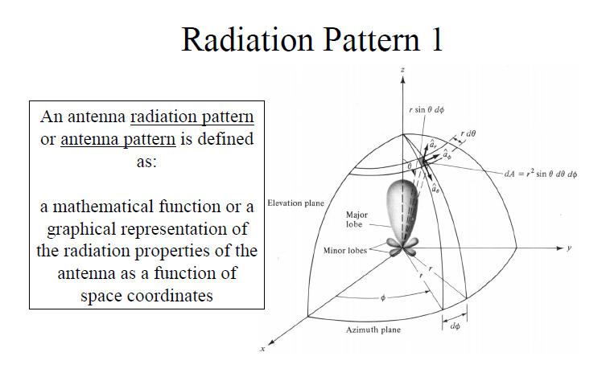
Results Discussion

Slide 26
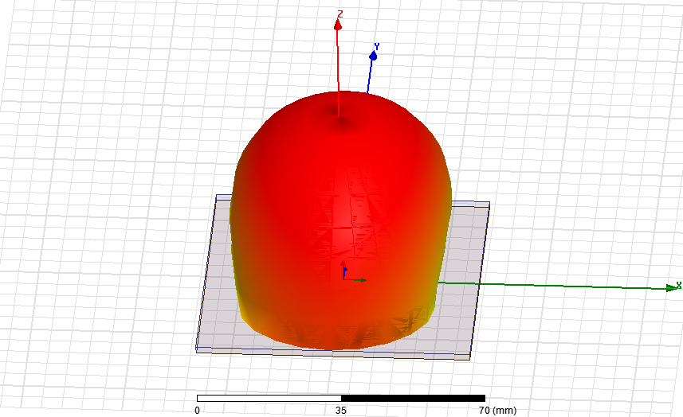
Results Discussion
Radiation Pattern

Slide 27
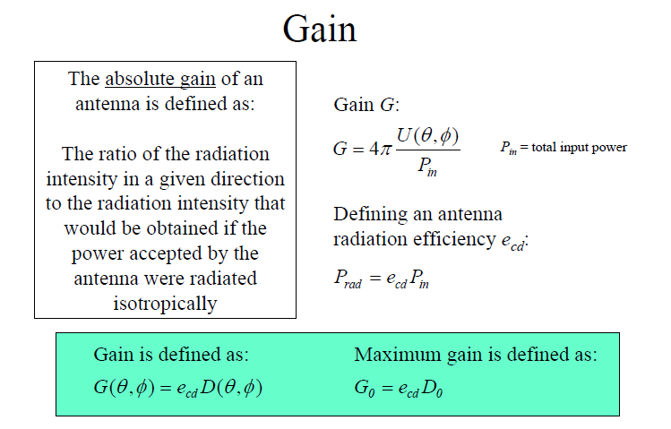
Results Discussion

Slide 28
Results Discussion
Gain

Slide 29
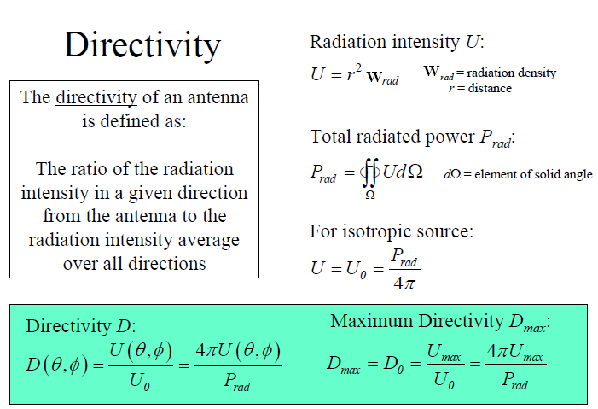
Results Discussion

Slide 30
Results Discussion
Directivity

Slide 31
Polarization
Polarization is the orientation of electric field component of an electromagnetic wave relative to the Earth’s surface.
Polarization is important to get the maximum performance from the antennas
There are different types of polarization (depending on existence and changes of different electric fields)
Linear
Circular (E_{x} and E_{y})
Elliptical

Slide 32
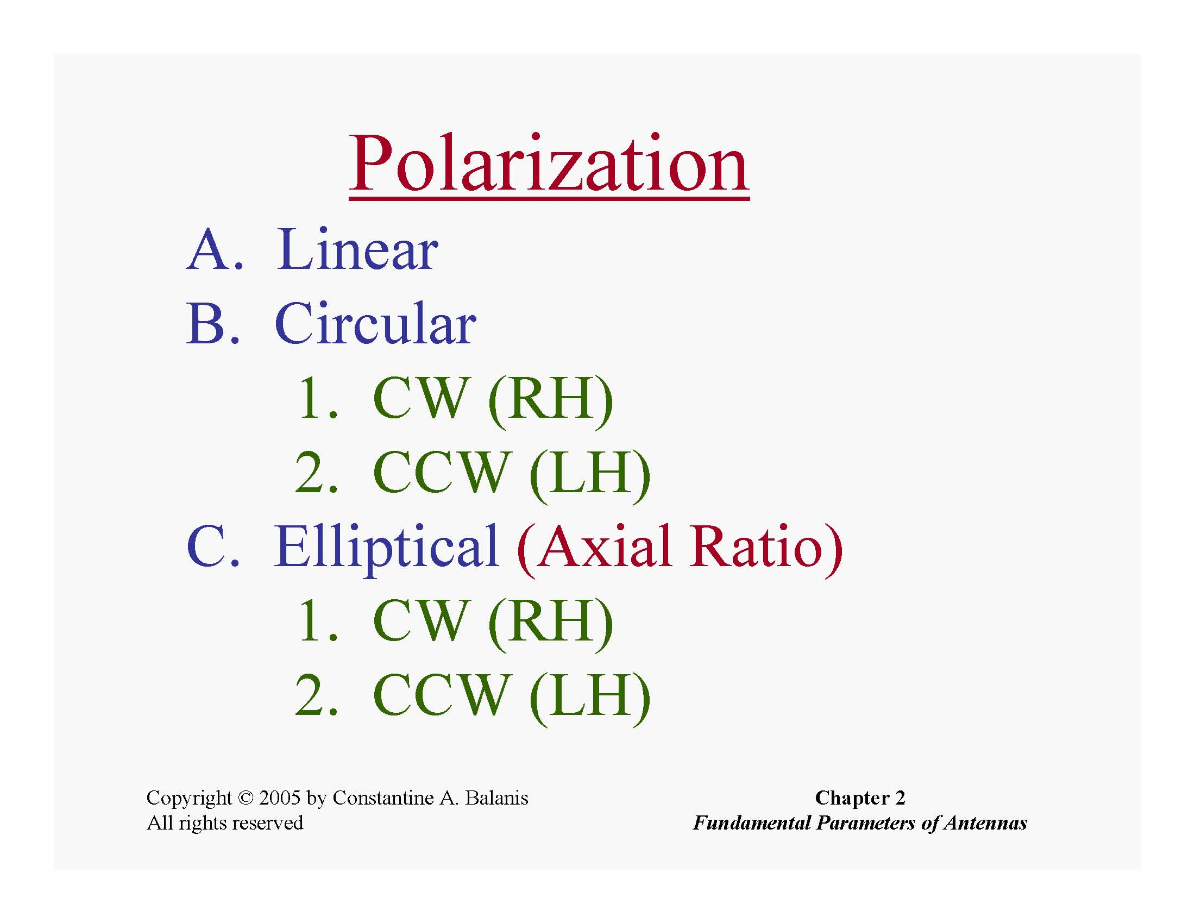

Slide 33
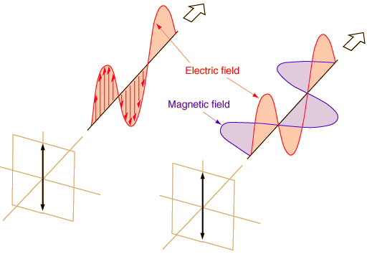
Linear Polarization
Vertical (E field going up/down with respect to earth’s surface)
Horizontal (E field changing in parallel with respect to earth’s surface)
Notes:
A transverse wave is a moving wave that consists of oscillations occurring perpendicular (or right angled) to the direction of energy transfer. If a transverse wave is moving in the positive x-direction, its oscillations are in up and down directions that lie in the y–z plane.
33

Slide 34

Linear Polarization
If the vector describes the electric field at a point in space as a function of time is always directed along a line, the field is said to be linearly polarized field.
The time-phase difference between the two components must be
Types:
Vertical polarized
Horizontal polarized

Slide 35
Linear Polarization
Vertical
Horizontal

Slide 36
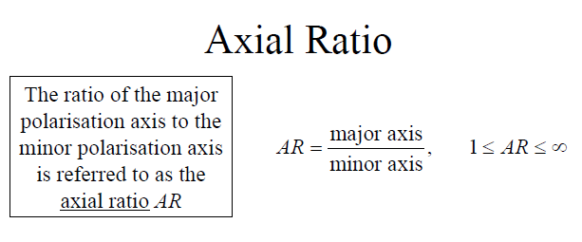
Results Discussion

Slide 37
Results Discussion

Slide 38

Antenna Radiation Efficiency
The conduction-dielectric efficiency e_{cd} is defined as the ratio of the power delivered to the radiation resistance R_{r} to the power delivered to R_{r} and R_{L} .

Slide 39
Results Discussion

Slide 40
Results Discussion
Comparative Analysis
Ref. Works | Substrate Material | ε_{r} | Antenna Dimensions (mm³) | f_{r} (GHz) | BW | Gain (dB) | η (%) | Polarization
1. | FR4 | 4.4 | 1822.8672 | 2.38 | 0.0525 | 1.9669 | 42.59 | Linear polarization

Slide 41
References
Khilare, Sunny, Rishabh Mhatre, Ganesh Kulkarni, Shahadev Hake, and Pune PICT. “ANTENNA DESIGN FOR WEARABLE MEDICAL DEVICES USING MBAN BAND.”
Zhu, Xiao-Qi, Yong-Xin Guo, and Wen Wu. "Miniaturized dual-band and dual-polarized antenna for MBAN applications." IEEE Transactions on Antennas and Propagation 64, no. 7 (2016): 2805-2814.
T. -W. Koo, J. -G. Yook, Y. -J. Hong, G. Park and K. Shin, "Low profile patch antenna for on-body wireless sensor application in MBAN band," Proceedings of the 2012 IEEE International Symposium on Antennas and Propagation, Chicago, IL, USA, 2012, pp. 1-2, doi: 10.1109/APS.2012.6349020.
Bhattacharjee, S., Midya, M., Mitra, M., & Bhadra Chaudhuri, S. (2019). Dual band- dual polarized planar inverted F-antenna for MBAN applications. International Journal of Microwave and Wireless Technologies, 11(1), 76-86. doi:10.1017/S1759078718001228

Slide 42
Thank you

